Slide 1
The Reality of Spiritual Warfare

Slide 2
“The enemy will not see you vanish into God’s company without an effort to reclaim you.”
-C. S. Lewis-

Slide 3
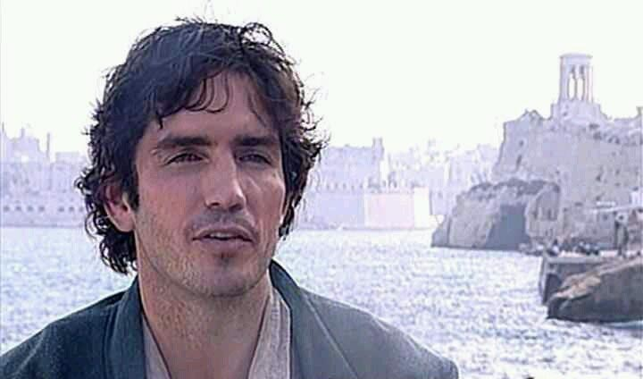
The Unseen Enemy

Slide 4
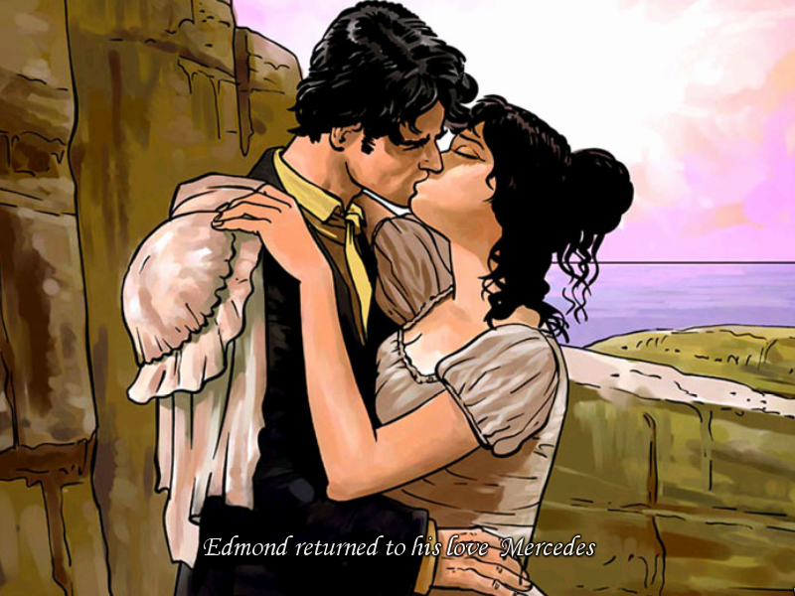
The Unseen Enemy

Slide 5
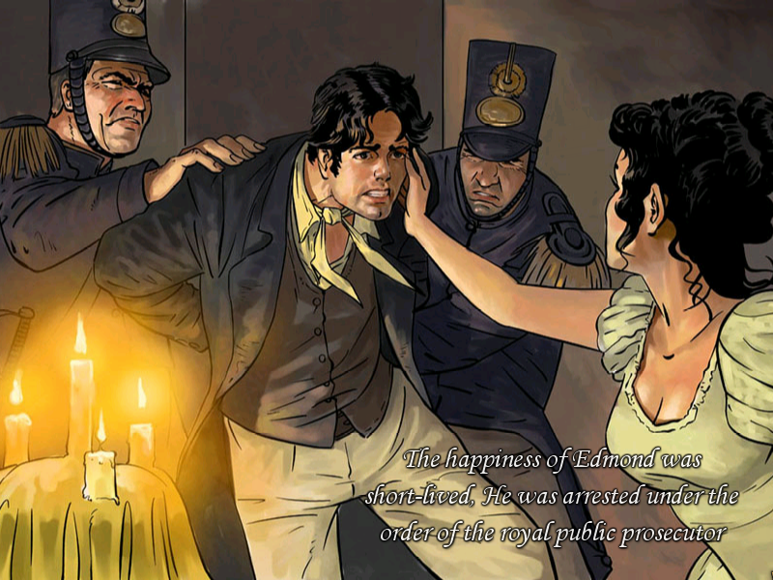
The Unseen Enemy

Slide 6
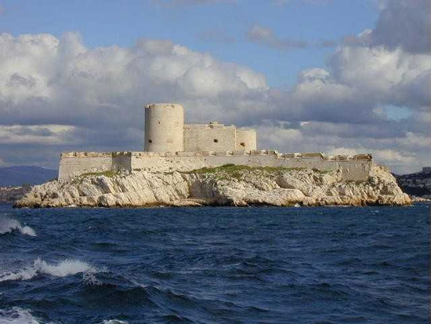
The Unseen Enemy

Slide 7
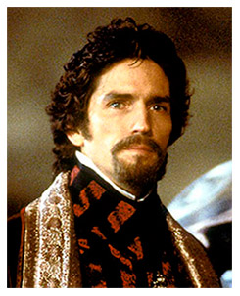
The Unseen Enemy
The
Count
of
Monte
Cristo

Slide 8
“… Our struggle is not against flesh and blood, but against the rulers, against the powers, against the world forces of this darkness, against the spiritual forces of wickedness in the heavenly places.”
(Ephesians 6:12)

Slide 9
“In the beginning God created the heavens and the earth.”
(Genesis 1:1)

Slide 10
“For my thoughts are not your thoughts, neither are your ways my ways, says the Lord. As the heavens are higher than the earth, so are my ways higher than yours, and my thoughts than your thoughts.”
(Isaiah 55:8-9)

Slide 11
“Truly, truly, I say to you, the Son can do nothing of Himself, unless it is something he sees the Father doing; for whatever the Father does, these the Son also does in a like manner.”
(John 5:19)

Slide 12
“From any tree of the garden you may eat freely; but from the Tree of the Knowledge of Good and Evil you shall not eat, for in the day that you eat from it you will surely die”.
(Genesis 2:16-17)

Slide 13

The 1st Act of Spiritual Warfare

Slide 14
“…continue to work out our salvation with fear and trembling.”
(Philippians 2:12)

Slide 15
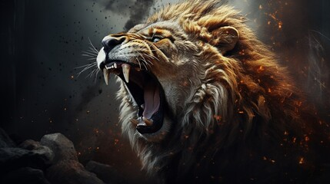
“Your adversary, the devil, prowls about like a roaring lion, seeking someone to devour.”
(1 Peter 5:8b)

Slide 16
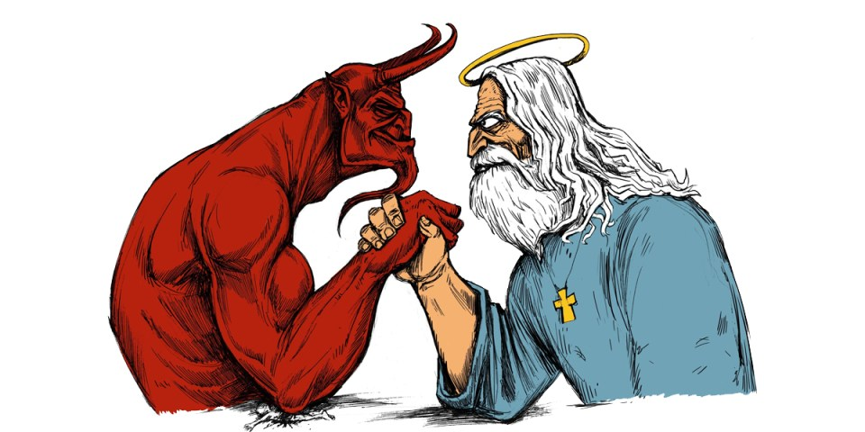
Popular Culture’s Devil

Slide 17
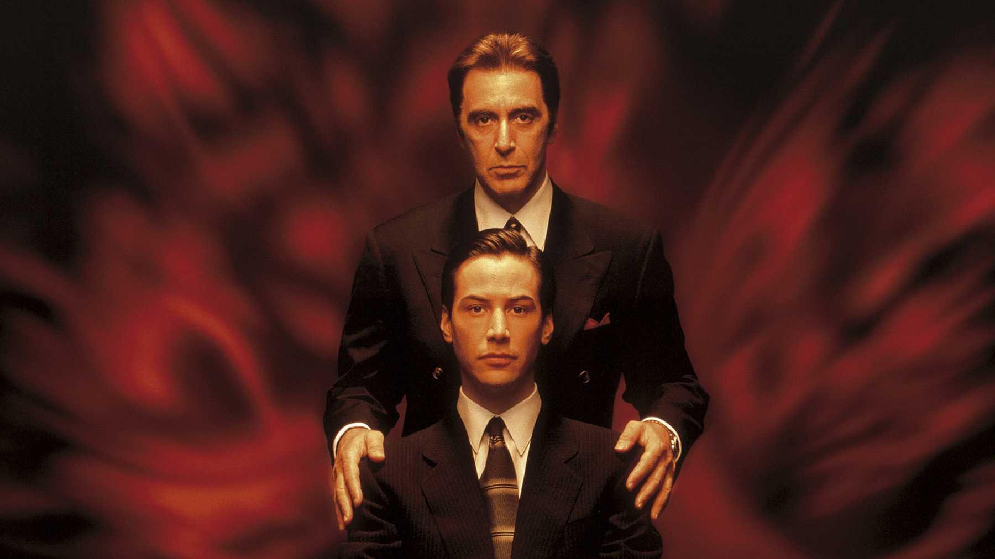
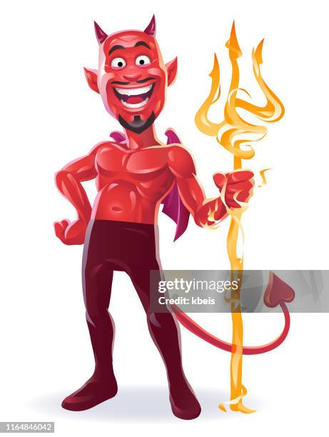
Popular Culture’s Devil

Slide 18
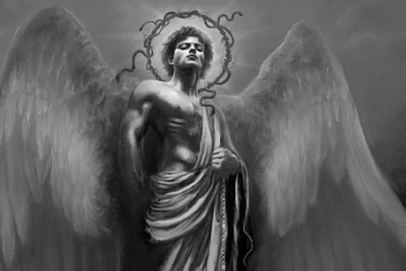
The Bible’s Devil
(II Corinthians 11:14)

Slide 19
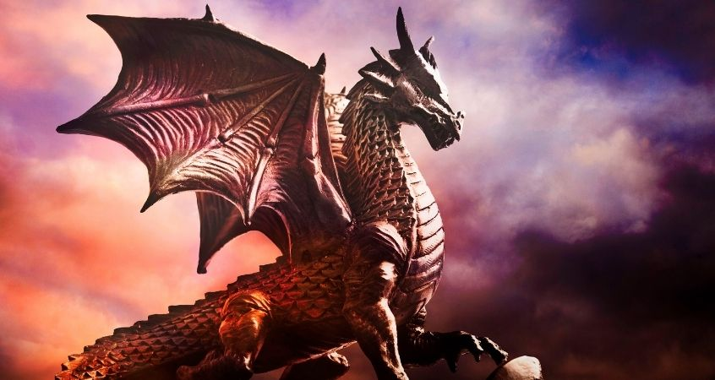
The Bible’s Devil
(Revelation 12:7-9)

Slide 20
But Wait There’s More!
Tiers of
Demonic
Spirits
RULERS
POWERS
WORLD FORCES OF DARKNESS
SPIRITUAL FORCES OF WICKEDNESS

Slide 21
So… How Should We Respond?
Be Alert
MAINTAIN SOBER VIGILANCE
_______________________________________
Be Equipped
PUT ON THE ARMOR OF GOD
_______________________________________________
Be Engaged
SERVE AND SUSTAIN EACH OTHER

Slide 22
So… How Should We Respond?
“…by His death He might render powerless him who holds the power of death – that is, the devil; and might deliver those who through fear of death were subject to slavery all their lives.”
(Hebrews 2:14b-15)

