Slide 1
The Sanctification of Suffering
Special Thanks to Joe Scheumann for his keen analysis

Slide 2
God’s Great Rescue Plan
Fallen Man
Prevenient Grace
God
Fallen
Sinful
Helpless
Mortal
Selfish
Death
Holy
Sinless
Able
Immortal
Love
Life
Payment for Sin

Slide 3
The Book Ends of History
SIN
Eden
Heaven
A
Garden
Paradise
Made for
Humanity
By
God
SEPARATION
SUFFERING
DEATH
A
Heavenly
Paradise
Prepared
For Us
By
Jesus

Slide 4
With SIN Came Suffering
God’s undeserved mercy saves us through our faith in Jesus
“For by grace you have been saved through faith…” (Ephesians 2:8)

Slide 5
With SIN Came Suffering
Still, sin, separation and suffering remain with us
“Through many tribulations we must enter the kingdom of God.” (Acts 14:22b)

Slide 6
With SIN Came Suffering
We long for heaven’s relief
“and He will wipe away every tear from their eyes; and there will be no longer any death… mourning… crying… or pain.” (Revelation 21:4)

Slide 7
But Until Then…
We must live with suffering
Does the Bible say anything about how to do that?

Slide 8
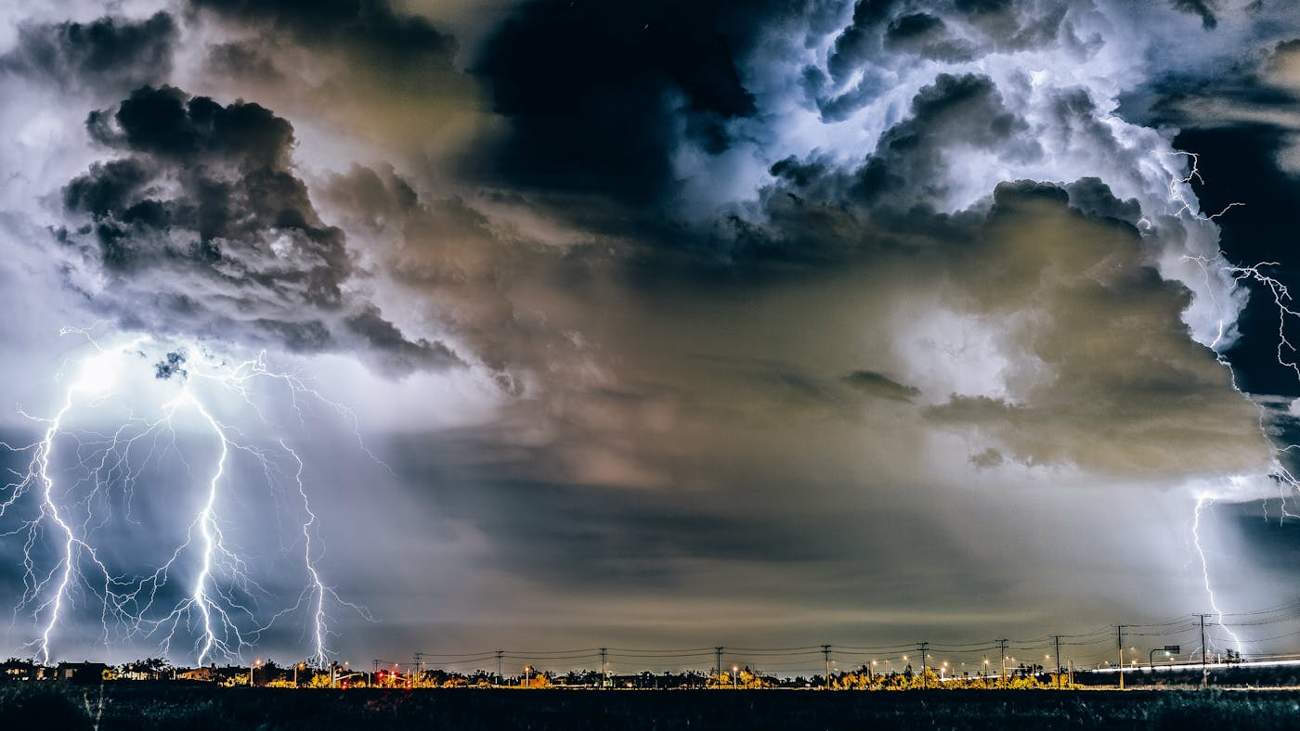

Slide 9
It’s a Battlefield
The struggle: curse or praise God
“Then his wife said to him, “Do you still hold fast to your integrity? Curse God and die!” But he said to her, “You speak as one of the foolish women speaks. Shall we indeed accept the good from God and not accept adversity?” (Job 2:9-10)

Slide 10
It’s Multifaceted
Mental, Physical, Emotional and/or Spiritual
“…we are afflicted in every way, but not crushed; perplexed, but not despairing; persecuted, but not forsaken; struck down, but not destroyed…” (II Cor. 4:8-9)

Slide 11
It’s Communal
We are one body in Christ Jesus
“Rejoice with those who rejoice and weep with those who weep.” (Romans 12:15)
“Bear one another’s burdens, and thus fulfill the law of Christ.” (Galatians 6:2)

Slide 12
It Equips Us for Ministry
“Blessed be… God… who comforts us in all our affliction so that we may be able to comfort those who are in any affliction with the comfort with which we ourselves are comforted by God.” (II Corinthians 1:4)

Slide 13
When you’ve passed through your own fiery trials, and found God to be true to what he says, you have real help to offer.
You have firsthand experience of both his sustaining grace and his purposeful design.
He has kept you through pain; he has reshaped you more into his image. . . .
What you are experiencing from God, you can give away in increasing measure to others.
You are learning both the tenderness and the clarity necessary to help sanctify another person’s deepest distress.
(Suffering and the Sovereignty of God by David Powlison)

Slide 14
It Preps Us for More Glory
Therefore, we do not lose heart, but though our outer man is decaying, yet our inner man is being renewed day by day. For momentary light affliction is producing for us an eternal weight of glory far beyond all comparison; while we look not at things visible and temporal, but the things that are invisible and eternal.” (II Cor. 4:16-18)

Slide 15
Suffering: God’s Multi-Tool
It helps us to choose God
It comes to us in many ways
It sands down our sharp edges
It makes us more like Jesus
It equips us to serve others who hurt
It brings us eternal glory

