Slide 1
The Fruit of the Spirit

Slide 2
A Quick Review
The Spirit is God just like the Father and the Son are God
The Spirit is Jesus’ Advocate
We are to walk with and be taught by the Spirit as if He were Jesus

Slide 3
A Quick Review
The Holy Spirit is our Locomotive
  His power is our strength, not ours
  His power must lead us, not ours
  We must remain connected to Him

Slide 4
A Quick Review
The Spirit equips us to do God’s work and will in the world
This is done via spiritual gifts of grace – All the gifts we ever need
We should seek God’s grace and be open to Him using us each as a dŏulŏs

Slide 5
A Quick Review
The purpose of these spiritual gifts is to build up the church
These gifts are not our talents or abilities, but are God’s provision
They are grace-gifts to us believers that release the power of Almighty God into this world through us

Slide 6
But Wait… There’s More!
Walking in the Spirit transforms us
It is a restorative process
We are slowly rehabilitated via the renewing and restoring influence of the Holy Spirit
Remember Bernie’s old truck?

Slide 7
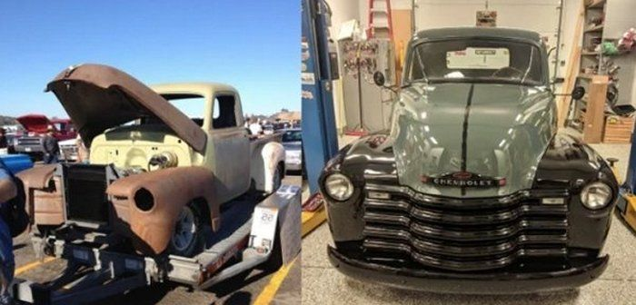
The Holy Spirit Changes Us
This happens over time as we submit to the Spirit’s leading for our lives

Slide 8
Sanctification is Gradual
Unlike an old truck we can resist the will of the Spirit – we can disobey or be unyielding
We are partners with God in this rehabilitation
We must conform our will to His will

Slide 9
What the Bible Says
“He saved us, not on the basis of deeds which we have done in righteousness, but according to His mercy, by the washing of regeneration and renewing by the Holy Spirit whom He poured out upon us richly through Jesus Christ our Savior…”
(Titus 3:5-6)

Slide 10
What the Bible Says
“Do not lie to one another, since you laid aside the old self with its evil practices, and have put on the new self who is being renewed to a true knowledge according to the image of the One who created him.”
(Colossians 3:9-10)

Slide 11
What the Bible Says
“And do not be conformed to this world, but be transformed by the renewing of your mind, that you may prove what the will of God is, that which is good and acceptable and perfect.”
(Romans 12:2)

Slide 12
What the Bible Says
“Therefore, we do not lose heart, but though our outer man is decaying, yet our inner man is being renewed day by day.”
(II Corinthians 4:16)

Slide 13
What the Bible Says
“So then, my beloved, just as you have always obeyed… work out your salvation with fear and trembling; for it is God who is at work in you, both to will and to work His pleasure.”
(Philippians 2:12-13)

Slide 14
What is God Working Out?
Put them all aside…
Therefore, consider the members of your earthly body as dead to:
Immorality
Impurity
Passion
Evil desire
Greed
Anger
Wrath
Malice
Slander
Abusive Speech
Colossians 3

Slide 15
What is God Working Out?
“For the flesh sets its desire against the Spirit, and the Spirit against the flesh; for they are in opposition to one another, so that you may not do the things that you please.”
Immorality
Impurity
Sensuality
Idolatry
Sorcery
Enmities
Strife
Jealousy
Outbursts of Anger
Disputes
Galatians 5

Slide 16
What is God Working Out?
“Walk no longer as the Gentiles walk...”
Dissensions
Factions
Envying
Drunkenness
Carousing
Futility of Mind
Hardened Heart
Filthiness
Silly Talk
Coarse Jesting
Covetousness
Unfruitful Deeds of Darkness
Ignorance
Galatians 5 & Ephesians 4 & 5

Slide 17
What is God Working Out?
“…that in reference to your former manner of life, you lay aside the old self, which is being corrupted in accordance with the lusts of deceit, and that you be renewed in the spirit of your mind, and put on the new self, which in the likeness of God has been created in righteousness and holiness of the truth.”
(Ephesians 4:22-24)

Slide 18
Old Self to New Self
EVENT
PROCESS
Saved by Faith
Justification
Declared Holy by God
Transformed by Faith
Sanctification
Made Holy by God

Slide 19

Old Self to New Self
Salvation is NOT the end all and be all of our faith
Salvation is merely its entry point or door
Becoming like Jesus is the primary goal of our faith
Sanctification is the house we enter via faith and live in to learn of and become like Jesus

Slide 20
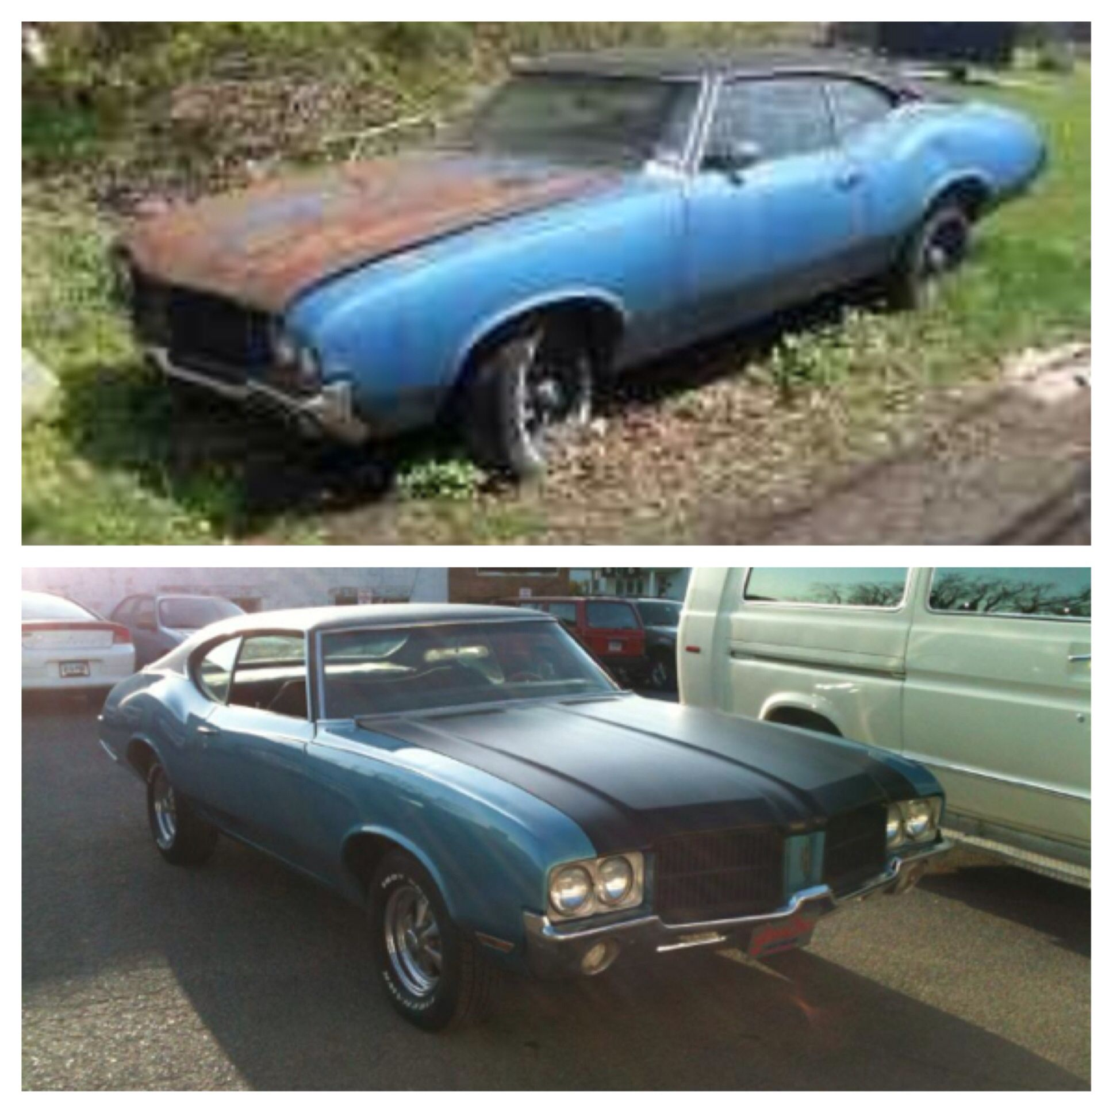
Old Self to New Self
Like the restoration of an old car we are renewed over time by the Spirit
Unlike such a car we must submit to the Spirit’s rehabilitation and alteration of our minds and lives
We must submit to the Spirit’s authority over us for change to occur

Slide 21
Old Self to New Self
FORESAKE
EMBRACE
Your Old Self/Life
False Religion
False Socio-Political Beliefs
Ungodly Personal Practices
Ungodly Interpersonal Practices
Your New Self/Life in Christ
True Faith in Christ
The Spirit’s Leading
Personal Holiness
Humility & Social Holiness

Slide 22
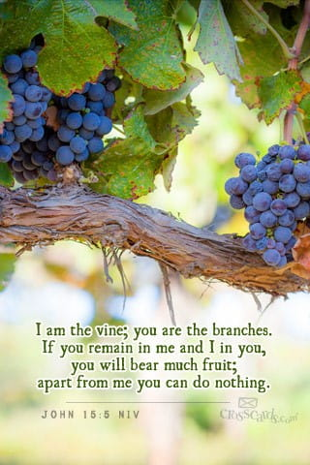
Old Self to New Self
If we cooperate with the Spirit He will indeed work to renovate our minds making us more and more like Jesus
If we submit to the Holy Spirit He will indeed produce much new behavioral “fruit” in and through our lives

Slide 23

Old Self to New Self

Slide 24

Father, I am your humble servant – Yours alone.
Fill me to overflowing with your grace.
May Your Spirit gift me however You choose.
Use me to build up Your Church.
Use me to make Jesus real all around me.
Empower me to commit patiently to this labor.
Draw me and Your whole church into wholeness and holiness in all things.
Help me to always abide in Jesus. Let me bear abundant spiritual fruit so that all who see me will know that You alone are God.
I ask this in the blessed name of Jesus my Lord, AMEN.

