Slide 1
Pruned Abiding Fruitful

Slide 2
The Context
John Chapter 15 right after Jesus:
  Institutes the Lord’s Supper
  Washes His disciples’ feet
  Predicts His betrayal

Slide 3
The Context
  Proclaims a NEW commandment
  Announces His departure
  Promises the Holy Spirit
Jesus is near the fruition of His earthly ministry

Slide 4
The Comparison
God the Father is the Vinedresser
The NT Greek word here is gĕōrgŏs
It means “to do the earth or ground” – as in a farmer or tiller
See Isaiah 5:1-7 as well as
Matthew 21:33-41 & Mark 12:1-9

Slide 5
The Comparison
Jesus is the True Vine
He is alēthinŏs – the real deal, genuine and ideal (in this case) vine that God has planted in His vineyard

Slide 6
The Comparison
Jesus’ followers are His branches
God prunes (kathairō) these branches to increase their fruitfulness
This means God cleanses the branches/purges them of all guilt

Slide 7
The Commands
“Abide in Me… My words… My love”
To bear any good fruit
To avoid the burn-pile fire
To have our prayers answered
To show we are Jesus’ disciples

Slide 8
The Commands
Mĕnō – means “to abide” in NT Greek: to wait or remain or tarry in a given state or relationship
In this case remain connected to Jesus in a close abiding relationship
This abiding = life and fruitfulness

Slide 9
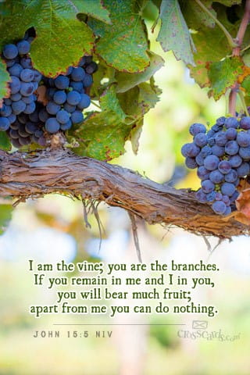
Abide in Jesus
ABIDE IN
Jesus
His words (rhēma)
His love (agapē)

