Slide 1
BIBLICAL
FATHERHOOD

Slide 2
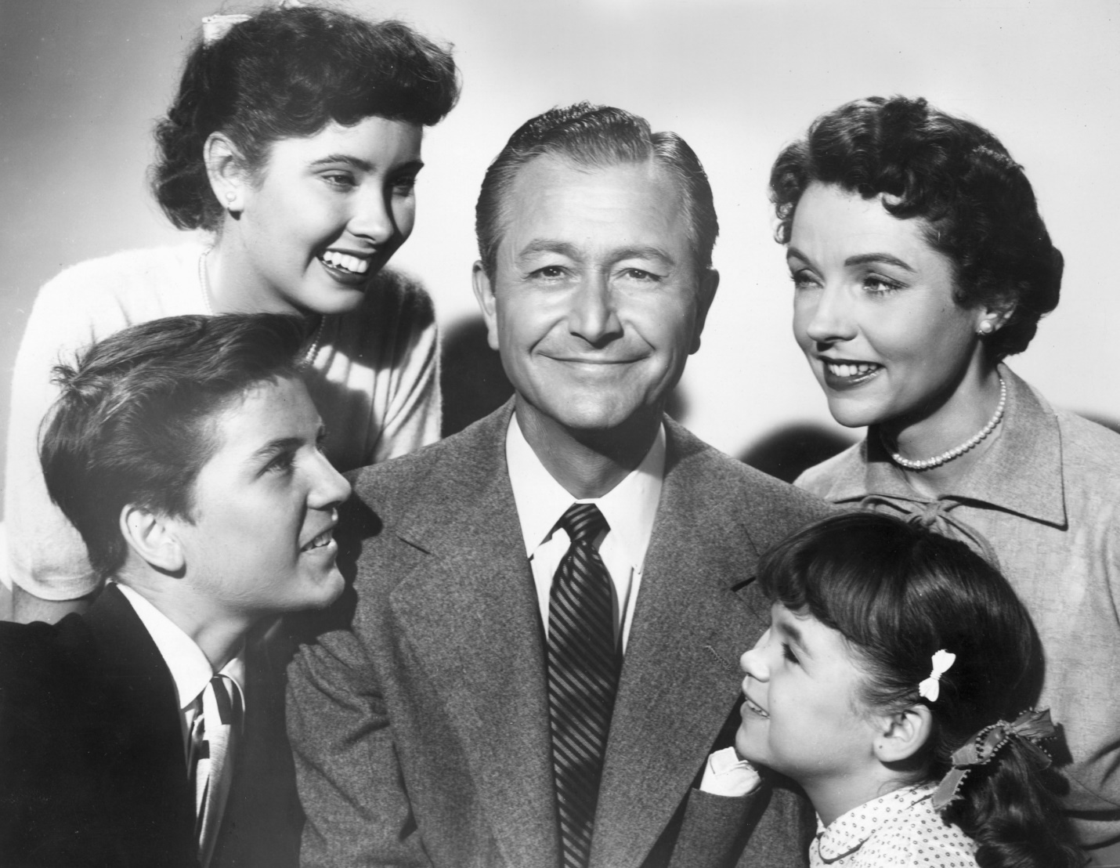

Slide 3
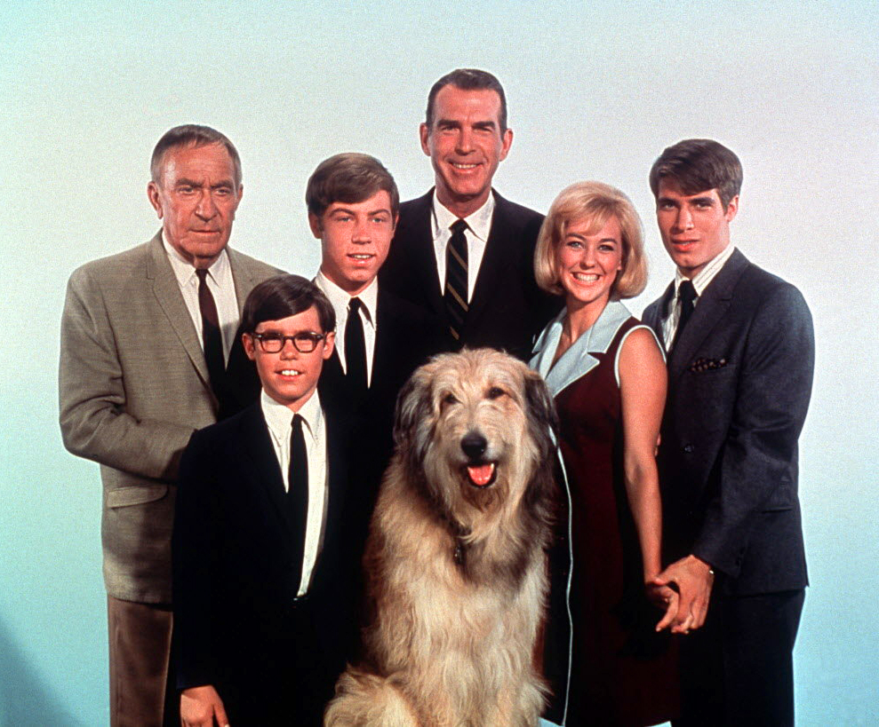

Slide 4
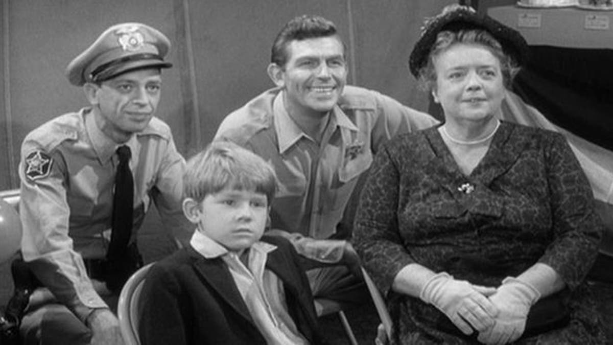

Slide 5
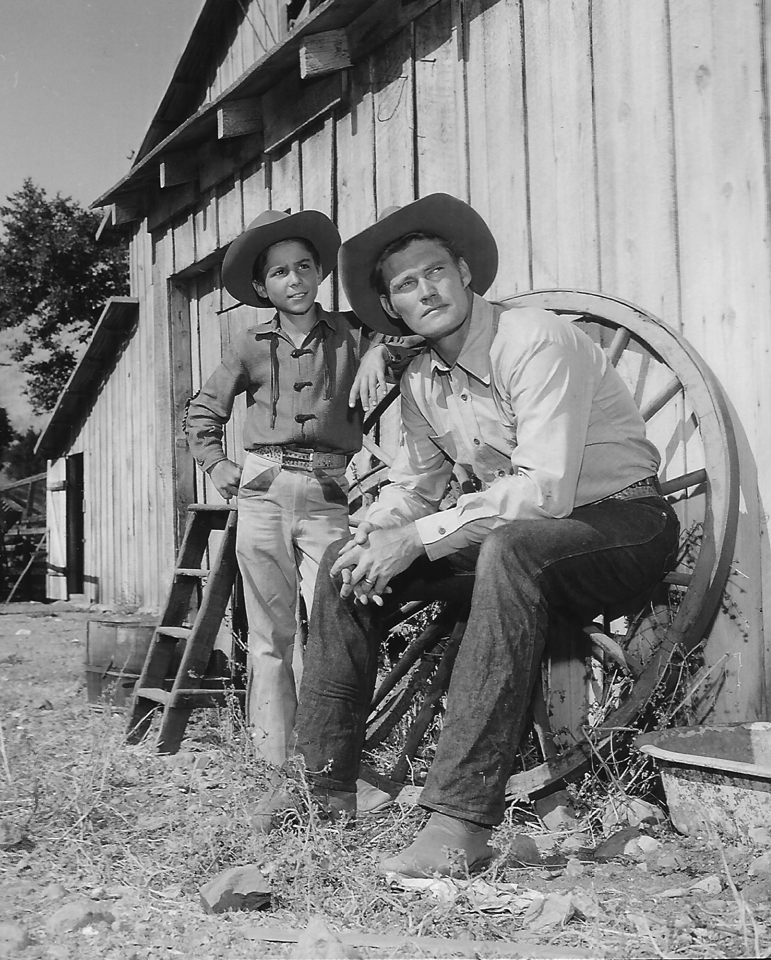

Slide 6
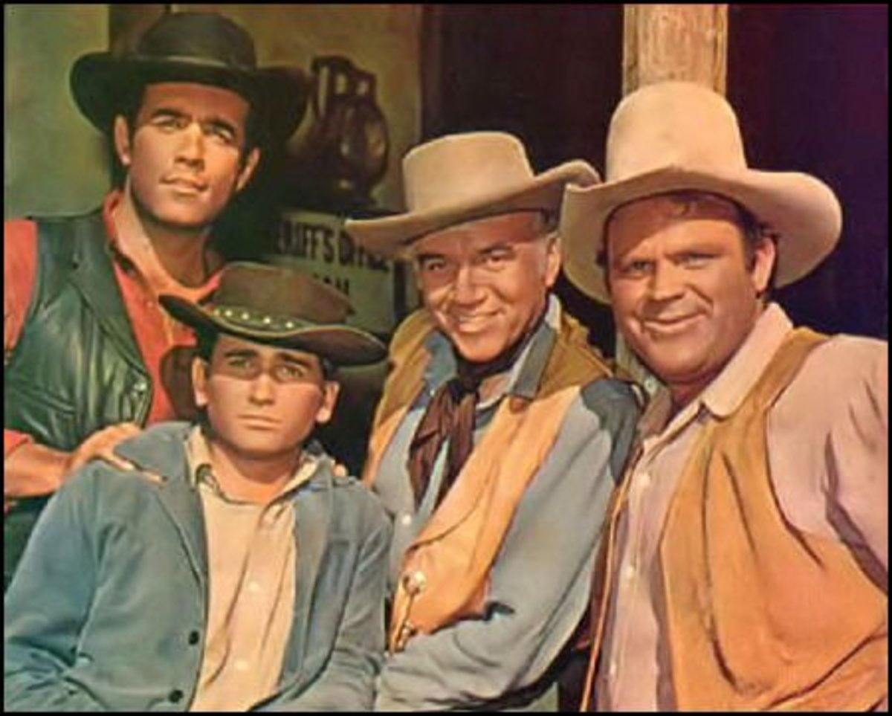

Slide 7
What “Father” Means
’Âb – The Biblical Hebrew word for “father” as well as grandfather, forefather or ancestor
Πατήρ – The Biblical Greek word used literally and figuratively for “father”

Slide 8
What “Father” Means
Pater or father comes from a root that means one who nourishes, protects, and/or upholds
Metaphorically, used of the originator of a group animated by the same spirit as himself

Slide 9
To Whom “Father” Refers
Used 268X for God and 150X for men/other beings in the Bible
Used of Abraham/the Patriarchs
Used of Satan
Used of those who exercise spiritual authority over others

Slide 10
To Whom “Father” Refers
Father = A man who:
  Sires a child
  Preaches to/teaches spiritual children
  Exercises spiritual authority
  Is the progenitor of a people

Slide 11
A Biblical Worldview
God is the Creator of everything
People are created male or female
People are commanded to be fruitful & fill the earth
The 1st use of “father” is in Genesis 2:24 where marriage is described

Slide 12
A Biblical Worldview
Fathers are male
Only 2 sexes: male and female
Sexual intimacy is for male-female dyads who are married
Fatherhood too is to be entered via the marriage partnership

Slide 13
The Great Disruption
Sin destroyed humanity’s relationship with Holy God
Sin damaged the relationship of men and women
Thus, human fruitfulness and life became more challenging

Slide 14
Sin Still Impedes
Today many believe they are better off w/o God & His design
Today many believe that people alone dictate their sex w/o regard for biological facts
Today many see sex as merely a personal preference or choice

Slide 15
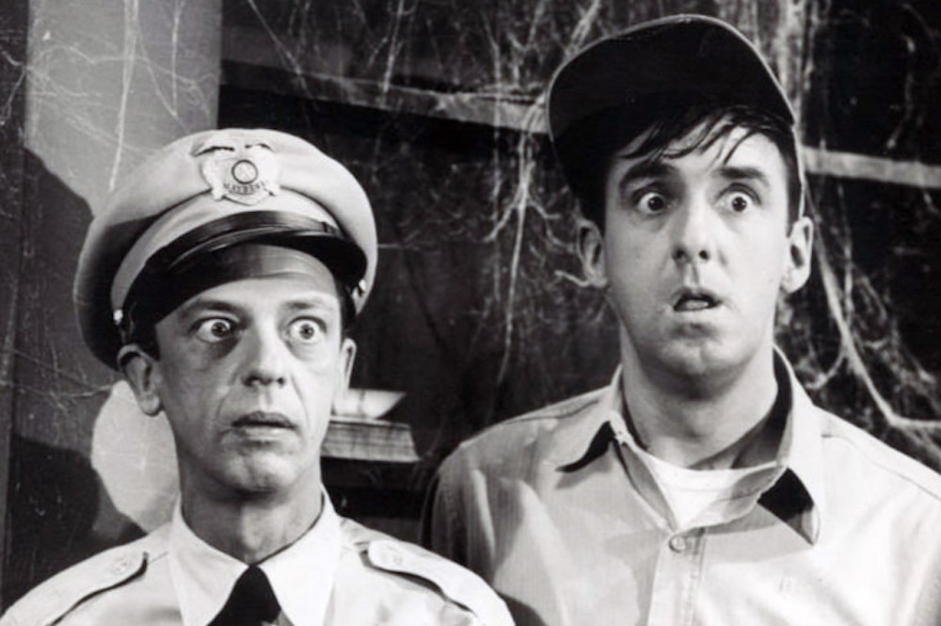

Slide 16
Fatherhood Crisis
Dads are important to their children’s well-being
In 1960 only 10% of kids lived in a home w/o their father
Today, 25-33% of kids live w/o their biological father
There are now 15-20 million such kids in the US

Slide 17
A Closer Look…
90% of homeless and runaway youth have no father in their lives
71% of all high school drop outs have no father in their lives
63% of all youth who commit suicide have no father in their lives

Slide 18
A Closer Look…
More likely to commit a crime and go to prison with no father in their lives
2 times more likely to drop out of school with no father in their lives
Twice the risk of dying in the first year of life with no father in their lives

Slide 19
A Closer Look…
More likely to have behavioral problems, specifically aggression with no father in their lives
2 times more likely to suffer obesity with no father in their lives
70% of incarcerated juveniles come from fatherless homes

Slide 20
A Closer Look…
The U.S. Census Bureau states 17.8 million children (nearly 1 in 4) live w/o a biological, step, or adoptive father in the home
That is enough children to fill New York City twice or Los Angeles four times over

Slide 21
A Father is a Protective Factor
4 times less likely to be poor
35% less likely to be poorer than his/her dad
3 times less likely to have an affective mental health disorder
3 times less likely to have early intercourse

Slide 22
A Father is a Protective Factor
6 to 7 times less likely to become pregnant as a teen
Half as likely to suffer from abuse or neglect
40% less likely to smoke, drink, or use drugs

Slide 23
A Father is a Protective Factor
21% more likely to be read aloud to every day
Half as likely to repeat a grade in school
Two times more likely to go to college

Slide 24
An Enduring Solution
When Adam and Eve sinned God did not abandon them
Instead God set up a great rescue plan to save us all from sin and restore our broken relationship with Him
It began in Eden and reached its fruition upon Calvary when Jesus died on the Cross and then rose from the grave

Slide 25
An Enduring Solution
A big part of God’s big rescue plan is us living in the world as his people – the family of God
God gives fathers a special place and role in His family

Slide 26
A Father’s Part
A Dad must be his child’s first teacher
“Train up a child in the way he should go, even when he is old he will not depart from it.”
(Proverbs 22:6)

Slide 27
A Father’s Part
A Dad must exemplify a good life
“You are our letter, written in our hearts, known and read by all men; being manifested that you are a letter of Christ, cared for by us, written not with ink but with the Spirit of the living God, not on tablets of stone, but on tablets of human hearts.”
(II Corinthians 3:2-3)

Slide 28
A Father’s Part
A Dad must provide for his family
“But if anyone does not provide for his own, and especially for those of his household, he has denied the faith and is worse than an unbeliever.”
(I Timothy 5:8)

Slide 29
A Father’s Part
A Dad disciplines his children
“He who spares the rod hates his son, but he who loves him disciplines him diligently.”
(Proverbs 13:24)

Slide 30
A Father’s Part
A Dad spends quality time with his children about God
“And these words, which I am commanding you today, shall be on your heart; and you shall teach them diligently to your sons and shall talk to them when you sit in your house and when you walk by the way and when lie down and when you rise up.”
(Deuteronomy 6:6-9)

Slide 31
A Father’s Part
A Dad is compassionate
“Just as a father has compassion on his children, so the Lord has compassion on those who fear him.”
(Proverbs 103:13)

Slide 32
A Father’s Part
A Dad doesn’t provoke his children
“And, fathers, do not provoke your children to anger, but bring them up in the discipline and instruction of the Lord.”
(Ephesians 6:4)

Slide 33
A Father’s Part
A Dad never gives up on his kids
“And he got up and went to his father. But while he was still a long way off, his father saw him, and felt compassion for him, and ran, and embraced him, and kissed him. And the son said to him, ‘Father, I have sinned against heaven and in your sight; I am no longer worthy to be called your son...’ But the father said to his slaves, ‘Quickly bring out the best robe and put it on him, and put a ring on his hand and sandals on his feet; and bring the fattened calf and kill it, and let us eat and be merry; for this son of mine was dead, and has come to life again; he was lost and has been found. And they began to be merry.”
(Luke 15: 20-24)

Slide 34
A Father’s Part
A Dad prays for his children
“And give to my son, Solomon, a perfect heart to keep thy commandments, thy testimonies and thy statutes, and to do them all, and to build the temple, for which I made provision.”
(I Chronicles 29:19)

Slide 35
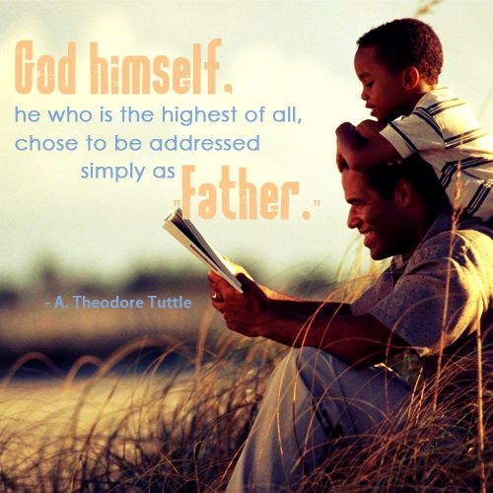

Slide 36
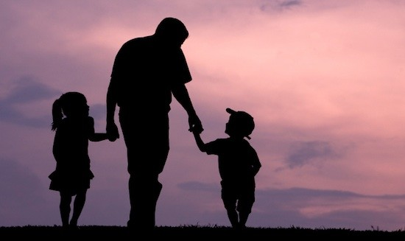
HAPPY
FATHER’S
DAY

