Slide 1
Spirit
Versus
Flesh

Slide 2
“It was for freedom that Christ set us free; therefore keep standing firm and do not be subject again to the yoke of slavery.” (Galatians 5:1)
“For you were called to freedom, brethren; only do not turn your freedom into an opportunity for the flesh, but through love serve one another.” (Galatians 5:13)

Slide 3
What Does Paul Mean?
The Galatian Christians were deceived into thinking they must still follow Jewish Law
Paul taught them they were free in Christ, but to follow Jewish Law was to be a slave to it
He also taught that they must not use their freedom as license to sin

Slide 4
Two Paths of Error
The Law
The Flesh
Law-Keeping
Expansion of rules
Legalism
Self-Pride and Judgmentalism
Ignoring the Law
Permissiveness
Antinomianism
Self-Pride and Judgmentalism

Slide 5
Freedom’s Purpose
To Love
To Serve
Agapē
Putting others on par with yourself
Sacrificially giving to the brethren
Douleuō
Humbly serving others’ needs
Sacrificially serving the brethren

Slide 6
Who Modeled Love/Service?
Putting others’ needs on par with or ahead of His own needs
Sacrificially giving to others
Humbly serving others
Sacrificially serving others

Slide 7
That’s Right, Jesus!
“Do nothing from selfishness or empty conceit, but with humility of mind let each of you regard one another as more important than himself; do not merely look out for your own interests, but also for the interests of others. Have this attitude in yourselves which was also in Christ Jesus…”

Slide 8
…who, although He existed in the form of God, did not regard equality with God a thing to be grasped, but emptied Himself, taking the form of a bond-servant, and being made in the likeness of men. And being found in appearance as a man, He humbled Himself by becoming obedient to the point of death, even death on a cross.

Slide 9
Therefore also God highly exalted Him, and bestowed on Him a name that is above every name, that at the name of Jesus every knee should bow…and every tongue confess that Jesus Christ is Lord, to the glory of God the Father.”
(Philippians 2:3-11)

Slide 10
But I’m Not Jesus…
Correct! We are NOT Jesus, but we abide in Him – our example
Jesus provided the means to obey His command and follow His example to us to love and serve one another
His provision is the indwelling of the Holy Spirit

Slide 11
But I’m Not Jesus…
“And I will ask the Father, and He will give you another Helper, that He may be with you forever; that is the Spirit of truth, whom the world cannot receive, because it does not behold Him or know Him, but you know Him because He abides with you, and will be in you.”
(John 14:16-17)

Slide 12
But I’m Not Jesus…
“But I tell you the truth, it is to your advantage that I go away; for if I do not go away, the Helper shall not come to you; but if I go I will send Him to you.”
(John 16:7)

Slide 13
But I’m Not Jesus…
“If you then, being evil, know how to give good gifts to your children, how much more shall your heavenly Father give the Holy Spirit to those who ask Him?”
(Luke 11:13)

Slide 14
Vessels of the Holy Spirit
“…be filled with the Holy Spirit.”
(Ephesians 3:19)
Jesus is our example, but the power to be like Him is found in His gift to us - the Holy Spirit

Slide 15

The Titanic Struggle
Walk by the Spirit
Do not fulfill the fleshly desires
Do not live under the Law
Be lead by the Holy Spirit

Slide 16

The Titanic Struggle
Walk in the Flesh
Indulge fleshly desires
Do not inherit the Kingdom of God
Oppose the Spirit
DEATH

Slide 17
It’s One or the Other
Walk by the Spirit
Pnĕuma
Context shows whether the term refers to God’s Spirit
The Holy Spirit
The Holy Ghost
Walk in the Flesh
Sarx
Weaker element in human nature
Seat of sin in man
The outward and illusory vs. the inward and real

Slide 18
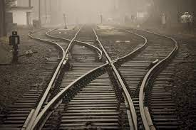
What Does Walk by the Spirit Mean?
It means the Holy Spirit is our locomotive
It means we rely on His strength – not ours
It means we are led by His power
It means we must remain connected to Him and go where He leads us

Slide 19
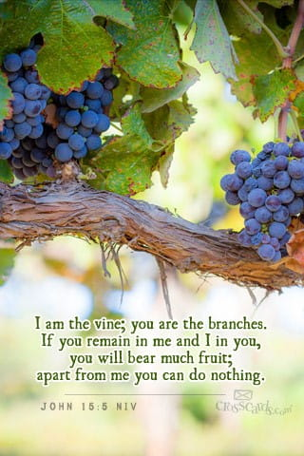
Jesus is the Vine and we are His branches
Via the Holy Spirit we overcome the influence of the flesh
Via the power of the Holy Spirit we bear fruit for Jesus
READ JOHN 15:1-11

Slide 20
Walking by the Spirit
It is being led by the Holy Spirit
It is bearing the fruit of the Spirit
It is submitting to the Spirit
It requires connection to the “locomotive”
It requires that we abide in Jesus

Slide 21
Vessels of the Holy Spirit
“…be filled with the Holy Spirit.”
(Ephesians 3:19)
Jesus is our example, but the power to be like Him is found in His 2nd gift to us - the Holy Spirit

