Slide 1
GOD’S WAY = LIFE
………

Slide 2
Is There Meaning and Purpose in Human Life?
Post-modern, non-theistic belief systems now dominate western culture and thus almost every facet of society: education, politics, governance, entertainment, liberal religions, language and even the practice of medicine
PMBS teach that “life” is a closed system: our existence is solely material with no spiritual component (read no God)

Slide 3
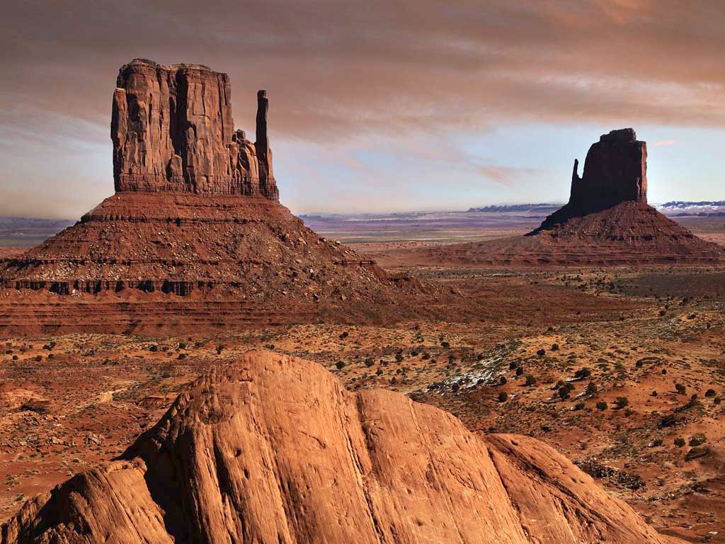
Existence is a vast wasteland without purpose or meaning

Slide 4
A PMBS Foments Hopelessness
Atheistic and materialistic beliefs do not fill the vacuum that is within each human being
Attempting to do so only makes one’s emptiness and angst worse
A PMBS does not provide meaning and purpose to existence
A PMBS does not provide a path through the wild wasteland of human existence

Slide 5
The Missing Piece
Isolation
Hopelessness
Escapism
Depression
Suicide
Something essential is missing

Slide 6
No What, But Who?
We can only be truly filled up by having God live within us
God indwells us when we invite Jesus into our lives by faith; and He will fill us to over-flowing with the Holy Spirit if we allow Him
The Father then adopts us as His own and gives us a life filled with meaning & purpose
He provides us a path through life and guides and directs our steps upon it

Slide 7
Life: Trusting God’s Way on Your Journey

Slide 8
The Path of Life
Psalm 16:11 – “You will make known to me the path of life; in Your presence is fullness of joy; in Your right hand are pleasures forever.”
Psalm 27:11 – “Teach me Your way, O Lord, and lead me in a level path.”

Slide 9
The Path of Life
Psalm 119:105 – “Thy word is a lamp unto my feet and a light unto my path.”
Psalm 139:3 – “You scrutinize my path and my lying down, and are intimately acquainted with all my ways.”

Slide 10
The Bible Says…
The Bible describes God’s plan for human living as a “path” or a “way”
In OT Hebrew:
’ôrach - a marked out, well-trodden course, road, caravan way, or highway
nthîbâh - a beaten path, a hiking trail, a by-way

Slide 11
The Bible Says…
The Bible describes God’s plan for human living as a “path” or a “way”
In NT Greek:
hŏdŏs - a natural path, road or way
Metaphorically, it denotes Jesus and the course of life, belief and conduct of His followers

Slide 12
Jesus is the Way
“… I go and prepare a place for you… And you know the way where I am going… Thomas said to Him, ‘Lord, we do not know where you are going, how do we know the way?’ Jesus said to him, ‘I am the way and the truth and the life; no one comes to the Father, but through Me.’”
(John 14:3-6)

Slide 13
Following Jesus is “the Way”
“Now Saul, still breathing threats and murder against the disciples of the Lord, went to the high priest, and asked for letters from him to the synagogue in Damascus, so that if he found any belonging to the Way, both men and women, he might bring them bound to Jerusalem.”
(Acts 9:1-2)

Slide 14
Jesus is THE Pathway of Life
Jesus is the only pathway to life in God
“Jesus said… I am the way and the truth and the life; no one comes to the Father but through Me.” (John 14:6)
“All who came before Me are thieves and robbers, but the sheep did not hear them… I came that they might have life and have it abundantly.” (John 10:8, 10b)

Slide 15
Jesus Paid for Our Faith Journey
Jesus made our path/walk possible
“… we have confidence to enter the holy place by the blood of Jesus, by a new and living way which He inaugurated for us through… His flesh…” (Hebrews 10:19-20)

Slide 16
Jesus Blazed THE Path for Us
Jesus pioneered our path through life
“If anyone serves Me, let him follow Me; and where I am, there shall My servant also be; if anyone serves Me, the Father will honor him.”
(John 12:26)

Slide 17
Jesus Awaits Us & is Our Advocate
Jesus is for us and lobbies for our success
“… if anyone sins we have an Advocate with the Father, Jesus Christ the righteous; and He Himself is the propitiation for our sins; and not for ours only, but for the sins of the whole world.” (I John 2:1-2)

Slide 18
Jesus Awaits Us & is Our Advocate
Jesus is for us and wants us to be with Him
“… I go to prepare a place for you. And if I go and prepare a place for you, I will come again, and receive you to myself; that where I am , there you may also be.” (John 14:2-3)

Slide 19
Many Have Walked Before Us
Our trail is well-trodden and easy to follow
“… since we have such a great cloud of witnesses surrounding us, let us also lay aside every encumbrance, and the sin which so easily entangles us, and let us run with endurance the race that is set before us, fixing our eyes on Jesus…” (Hebrews 12:1-2a)

Slide 20
A Critical Caveat
There are competing paths for your life
“Enter by the narrow gate; for the gate is wide and the way is broad that leads to destruction, and many are those who enter by it. For the gate is small and the way is narrow that leads to life, and few are those who find it.” (Matthew 7:13-14)

Slide 21
A Critical Caveat
Competing paths lead to destruction
“And many will follow their sensuality , and because of them the way of the truth will be maligned; and in their greed they will exploit you with false words; their judgment from long ago is not idle, and their destruction is not asleep.” (2 Peter 2:2-3)

Slide 22
A Critical Caveat
“There is a way that seems right to a man, but its end is the way of death.”
(Proverbs 14:12)

Slide 23
Each Person Choses a Path
Way of Self and Destruction
Way of God and Life
C
H
O
I
C
E

Slide 24
The Road Not Taken
Two roads diverged in a yellow wood, and sorry that I could not travel both and still be one traveler; long I stood and looked down one as far as I could to where it bent in the undergrowth, then took the other, as just as fair, and having perhaps the better claim for it was grassy and wanted wear, though as for that, the passing there had worn them really about the same.

Slide 25
And both that morning equally lay in leaves no step had trodden black. O, I kept the first for another day! Yet, knowing how way leads on to way I doubt if I should ever come back. I shall be telling this with a sigh somewhere ages and ages hence: Two roads diverged in a wood and I took the one less traveled by and that has made all the difference.
- Robert Frost -

Slide 26
Choose Life!

