Slide 1
Belief and Alignment

Slide 2
A Not-So-Brief History Lesson…
The Bible recounts God’s history of saving actions to liberate humanity from the power and penalty of sin
Why? God loves us! He wants to be in relationship with us: to live in intimate fellowship with us and in us

Slide 3
A Not-So-Brief History Lesson…
God’s history of saving acts begins in the Garden of Eden in Genesis 3 with the promise a Deliverer who would save us from our sins
God’s chosen avenue for providing this great Savior came through a man named Abraham and his descendants – the Jews

Slide 4
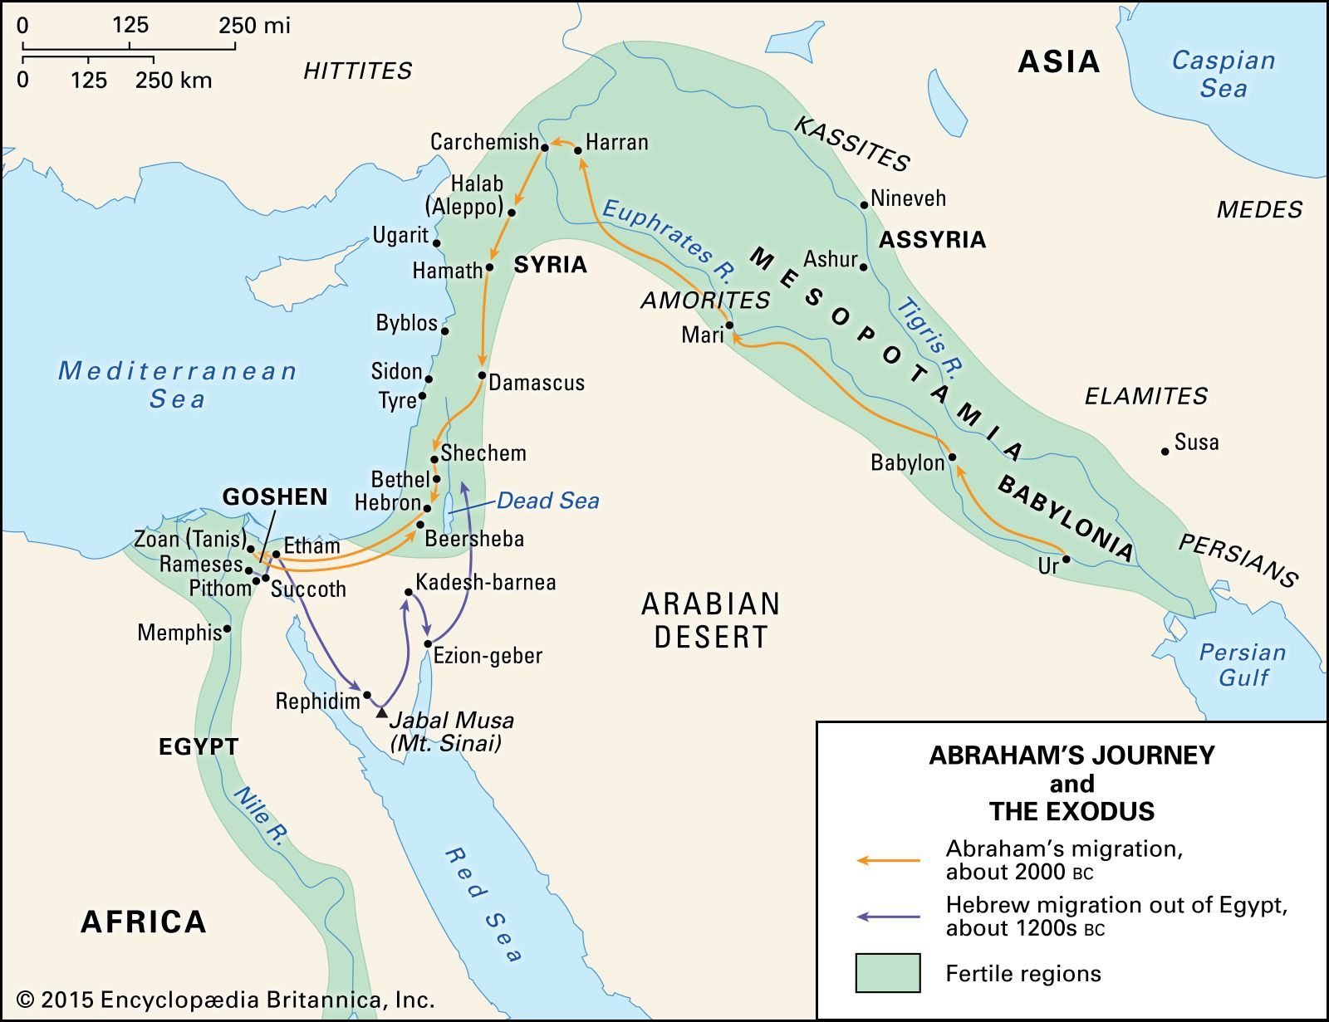
Abraham traveled the Fertile Crescent to the Promised Land

Slide 5
A Not-So-Brief History Lesson…
Thus, the Bible is a timeline of God’s great rescue plan to save us from sin
God’s plan came to fruition in the life, atoning death and resurrection of Jesus
Through Jesus the penalty for human sin was paid for and the power that sin has over us was broken

Slide 6
A Not-So-Brief History Lesson…
Prophets, priests and kings envisioned the coming of a great king who would deliver the Jewish people from their sins and their worldly oppressors
Over time religious scholars and teachers began to teach that this king would establish the Jews as rulers over all the earth and that the nations would one day serve, honor and pay tribute to them

Slide 7
A Not-So-Brief History Lesson…
But the children of Israel proved to be a fickle people in spite of God’s many miracles, promises and blessings
They failed to honor their promises to God
They regularly followed after other gods and participated fully in their utterly profane rituals and practices

Slide 8
A Not-So-Brief History Lesson…
Thus, God punished them through great kingdoms of the earth: Assyria, Babylon and Persia
Judah suffered 70 years of captivity in a foreign land before their restoration to the land promised to Abraham generations before

Slide 9
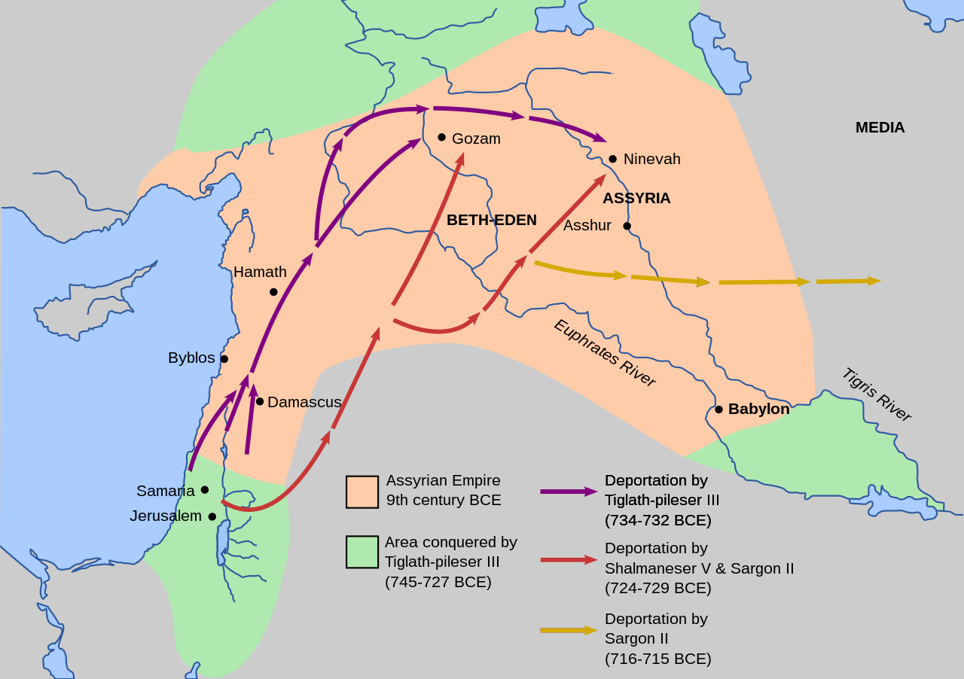
Jews were deported by the Assyrian and the Babylonian Empires

Slide 10
A Not-So-Brief History Lesson…
When the Jews finally returned to the Promised Land they had permission and materiel from Cyrus, Emperor of Persia, to rebuild God’s temple and the walls of the Holy City – Jerusalem
Humbled, when a new conqueror arose they did not resist him, but instead welcomed him as a prophesied deliverer

Slide 11
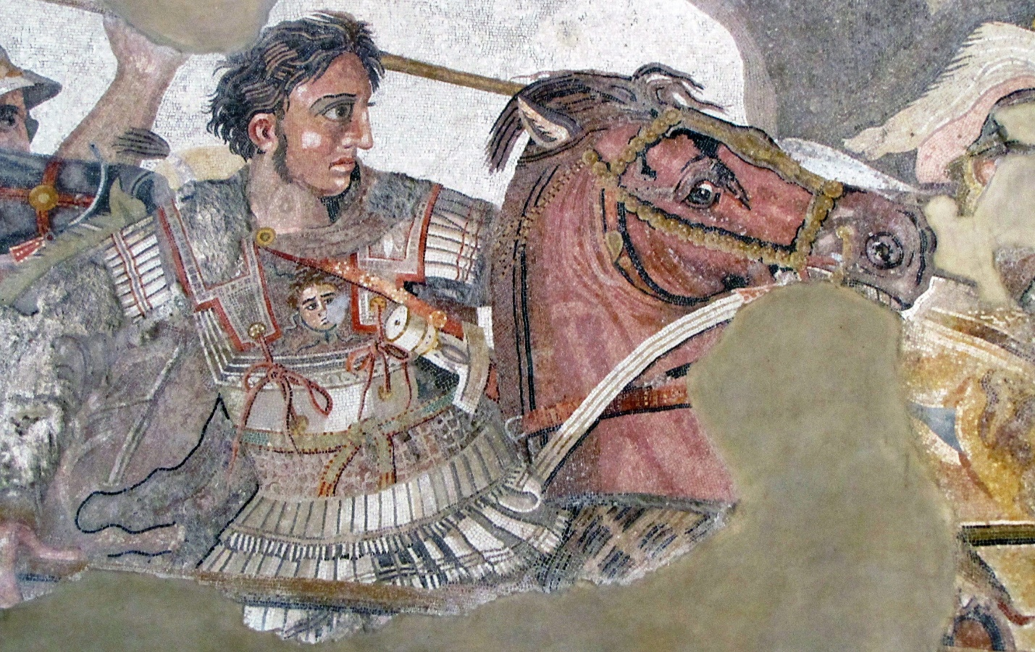
Alexander the Great would conquer all of Persia, and even India

Slide 12
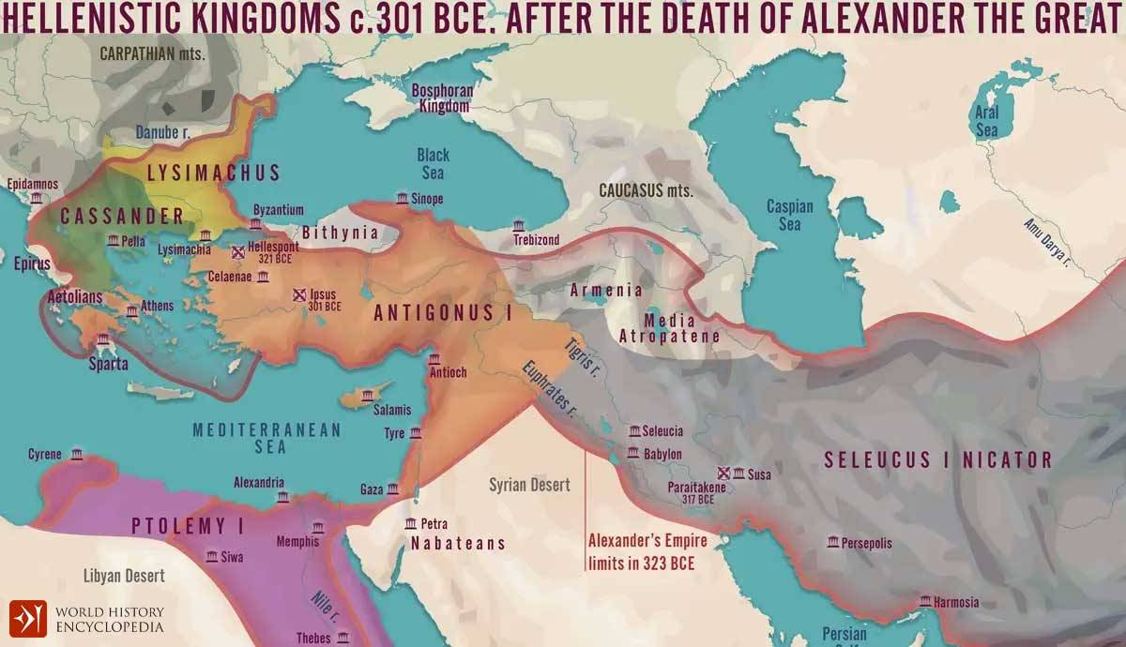
Alexander’s empire was divided among
“the Successors”

Slide 13
A Not-So-Brief History Lesson…
Antigonus – the most powerful of the successors was ganged up on by the others
His territory was absorbed by Seleucus
His eventual heir, Antiochus Epiphanes, sought to unite his vast holdings under Hellenism
Judea was a tiny part of his holdings, but the Jews stubbornly refused to comply

Slide 14
A Not-So-Brief History Lesson…
The many abuses and sacrilege of Antiochus caused the Jews to revolt
The rebellion was led by the Maccabaeus brothers – sons of a high priest
Their heroic sacrifices eventually won the Jews their freedom
Hanukah is the Jews’ annual remembrance of their deliverance

Slide 15
A Not-So-Brief History Lesson…
Judas Maccabeus pursued a compact with Rome to keep the Seleucids at bay
When Judas died in battle the Romans became more deeply involved in Israel
The Romans backed Herod the Great as king of Israel to ensure a strong and reliable friend was at the helm of an unstable region

Slide 16
A Not-So-Brief History Lesson…
They also installed a new high priest
Many Jews thus saw Herod as a puppet of Rome and, being Idumean, as only half-Jewish
How and why should HE be their king?!
They saw the Romans as invaders, not peacekeepers

Slide 17
A Not-So-Brief History Lesson…
The Jews wanted a deliverer like Judas Maccabeus to drive out their Roman invaders and make them free
They craved justice even at the point of a sword
They needed a warrior king like David to destroy their enemies and ensure the true worship of God

Slide 18
A Not-So-Brief History Lesson…
In short, they desperately needed a MESSIAH
They knew by heart all the Scriptures that prophesied a deliverer would come and set them free
They had desperate faith that God would fulfill His promise and deliver them
They knew what they wanted and they wanted it now

Slide 19
A Not-So-Brief History Lesson…
But they never got what they wanted…
God intended them to have something completely beyond what they felt they needed
God wanted to destroy their real enemy – sin

Slide 20
A Not-So-Brief History Lesson…
God wanted them to become like Him motivated by selfless love, not by religion
God wanted them to make Him undeniably real in the world outside the temple gates and Judea’s borders
That’s why God gave them a true deliverer – Jesus!

Slide 21
How Could They Be So Off-Base?
When we think we know what God MUST do…
When we try to make happen what we deeply know in our hearts God must want…
When we can make a strong case for our thoughts and actions via the Scriptures…
We are on a slippery slope!

Slide 22
How Could They Be So Off-Base?
The Jews did not seek to “do only what my Father in heaven is doing”
They did not think they could be wrong
Their terrible need drove and reinforced their conclusions making them blind and deaf to God’s actions and voice

Slide 23
The Great Penalty
Because the Jews “did not recognize the time of their visitation” the would suffer a great loss:
Their nation, capitol city and temple, would be utterly destroyed
The Jews would be cast into the diaspora
Their ministry as God’s people in the world would be taken from them and given to the Gentiles

Slide 24
But by the Grace of God There Go We
God reveals His character and expectations in the Holy Scriptures
We as people of faith, like our Jewish forebears, can read, grasp and apply the Scriptures
But we must remain humble and let the Holy Spirit inform and lead our spirits about what God wants to do and how He will do it

Slide 25
But by the Grace of God There Go We
We must BELIEVE in God
We must have faith in His promises
BUT… we must also remain in ALIGNMENT with what , when and how GOD is doing, not aligned with our own thoughts of what, when or how something must be done

Slide 26
But by the Grace of God There Go We
To do this is to imitate Jesus who only did what He saw His Father in heaven doing
To do this one must be led by and remain in step with the Holy Spirit
To do this we must maintain the attitude of a humble bond-servant

Slide 27
Homework!
Prayerfully discern where God wants us to focus to make His presence felt and to achieve His vision for our church:
Prioritize the top (3) priorities of our church
What are the top (3) things we must do as a church to achieve our vision?
What are the top (3) needs of our surrounding communities and region; and beyond?

