Slide 1
Untruth and
Consequences

Slide 2
Have You Noticed?
The world around us is changing dramatically
This striking series of changes seems to be occurring faster than ever before
These changes are occurring across many aspects of our society

Slide 3
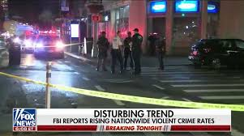
Have You Noticed?
Crime is rampant and becoming more violent

Slide 4

Have You Noticed?
Drug Abuse is at an All-Time High

Slide 5
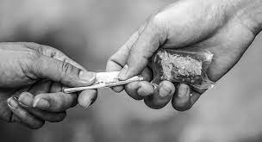
Have You Noticed?
Drug Trafficking is at an All-Time High

Slide 6
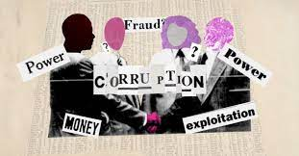
Have You Noticed?
Corruption is now common in every level of our governing bodies

Slide 7

Have You Noticed?
Strange Political, Social and Religious Ideas are Sprouting Up Like Weeds

Slide 8

Have You Noticed?
Strange Political, Social and Religious Ideas are Sprouting Up Like Weeds

Slide 9
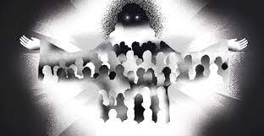
Have You Noticed?
Strange Political, Social and Religious Ideas are Sprouting Up Like Weeds

Slide 10
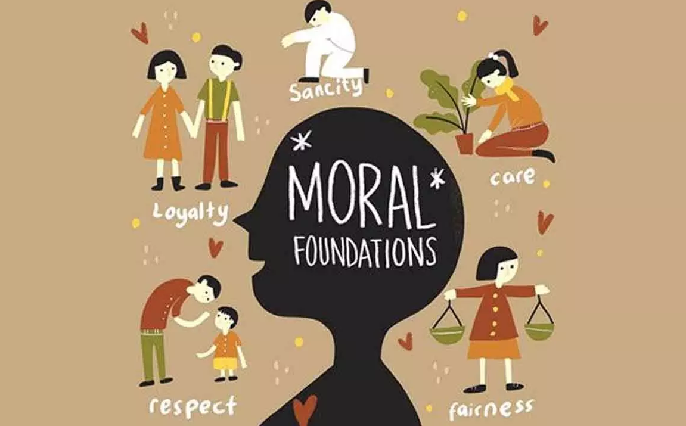
Have You Noticed?
Morals Foundations are Eroding

Slide 11
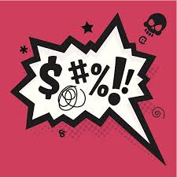
Have You Noticed?
Etiquette
Politeness
Decorum
Best Behavior
Class
Standards
Friendliness
Respectfulness
Genuineness
Consideration of Others is Waning

Slide 12
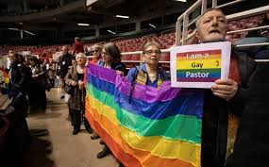
Have You Noticed?
Churches are Embracing Apostasy

Slide 13
What Does This All Mean?
Our nation and culture are departing from the Judeo-Christian foundation upon which it was based and built
In its place many in America are embracing an ancient worldview
They are forsaking God and His life-giving guidance for a myopic, human-centered view of life that invites judgment and death

Slide 14
Nothing New Under the Sun…
History is replete with examples of people choosing themselves over God
People consistently choose self over God and the secular over the sacred
This only changes when God dwells within a person by faith
Humanity
Sexuality
Morality
Religion
Politics
& more
Notes:
History is replete with examples of people choosing themselves over God

Slide 15
This Attitude Touches the Church
It is in every denomination
It causes some to leave orthodox belief
It causes some to re-write the Bible
Some re-interpret the Bible and theological ideas
Others twist and use Christian principles to sell change

Slide 16
This Attitude Touches the Church
Some diminish the Bible and replace it with worldly political or social ideas
They change social rules “to bring about God’s kingdom “– not change individuals
They elevate secondary or tertiary theological concepts over primary beliefs
They employ buzz words like fairness, justice or love to manipulate the unwary

Slide 17
Why Does This Happen?
All people are sinners
In our nature we are inclined towards our self and away from God and His ways
Without the restraining and renewing influence of the Holy Spirit even the redeemed might backslide into sin
Such rebellion always results in destruction and spiritual death

Slide 18
Why Does This Happen?
Trying to make meaning out of life without the Author of life invites disaster
This pattern we are experiencing right now occurs throughout the Bible
Simply look at Israel in the OT, the NT church and today’s modern church
The pattern: Fellowship with God, Falling away, Punishment , Restoration/Destruction

Slide 19
What Must We Do?
We must always align ourselves with God
We must know God’s Word
We must diligently follow the leading of the Holy Spirit – our paraclete
We must never let our Bible-based faith be undermined by what the world calls “normal”

Slide 20
What Must We Do?
Never allow corrupt, wicked church officials to place you on the path of judgment and destruction – even when they appeal to you in the name of tolerance, fairness or love
In this manner you will never embrace heresy, false religion or the practices of those “more sophisticated” than us: those who claim to “know better” than God

Slide 21
What Must We Do?
Above all else we must:
PRAY!
For Revival of our
Selves
Community
Country
World

Slide 22
What About You?
Are you taking your instructions for life from the world or from the Lord?
Have you embraced the new and popular at the expense of the true and eternal?
Such actions must cease:
“There is a way that seems right to a man, but in the end it is the way of death”
(Proverbs 14:12)

Slide 23
Repent and Belief the Gospel!
Now is the day of salvation!
There is no other name under heaven by which you may be saved - only Jesus’ name
Leave the world and its many deceptions behind
Embrace Jesus as your Savior and Lord
Let Him teach you His ways and live!

